Slide 1
Final Project Presentation
BLG 506E – COMPUTER VISION
BURAK BOZDAĞ - 504211552

Slide 2
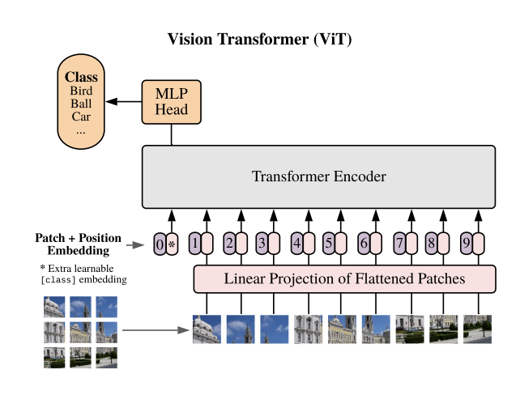
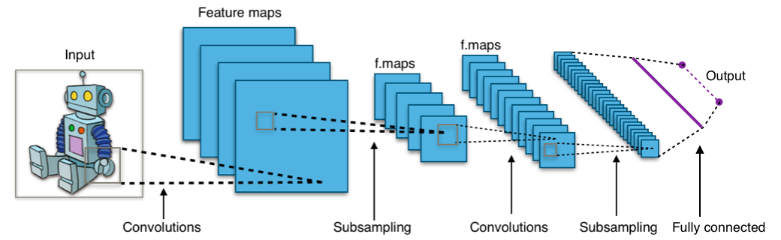
About the Project
Classifying Chest X-Ray Images Using CNN and Transformer Based Architectures
Comparing CNN and transformer models for classifying patients as normal or infected
CNN

Slide 3
Motivation
CNN is a standard in CV
Transformer based models in NLP
A. Dosovitsky et al., "An Image is Worth 16x16 Words: Transformers for Image Recognition at Scale", 2021. Available: https://openreview.net/forum?id=YicbFdNTTy.
Transformers applied directly to image patches and pre-trained on large datasets work really well on image classification.
Find out which is better for classifying x-ray images

Slide 4


Applied Processes and Methods
TensorFlow, Keras
Examining Dataset
Data Augmentation
ViT Evaluation
CNN Evaluation

Slide 5
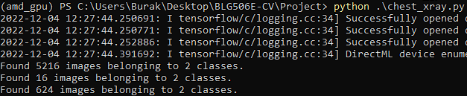
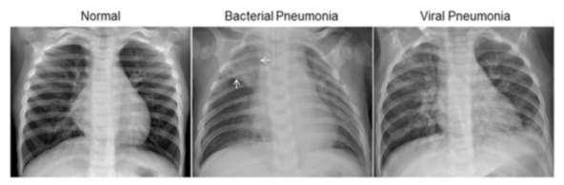
Dataset
Chest X-Ray Images (Pneumonia) [1]
5856 JPEG images (1.15 GB)
5216 train
16 validation
624 test

Slide 6
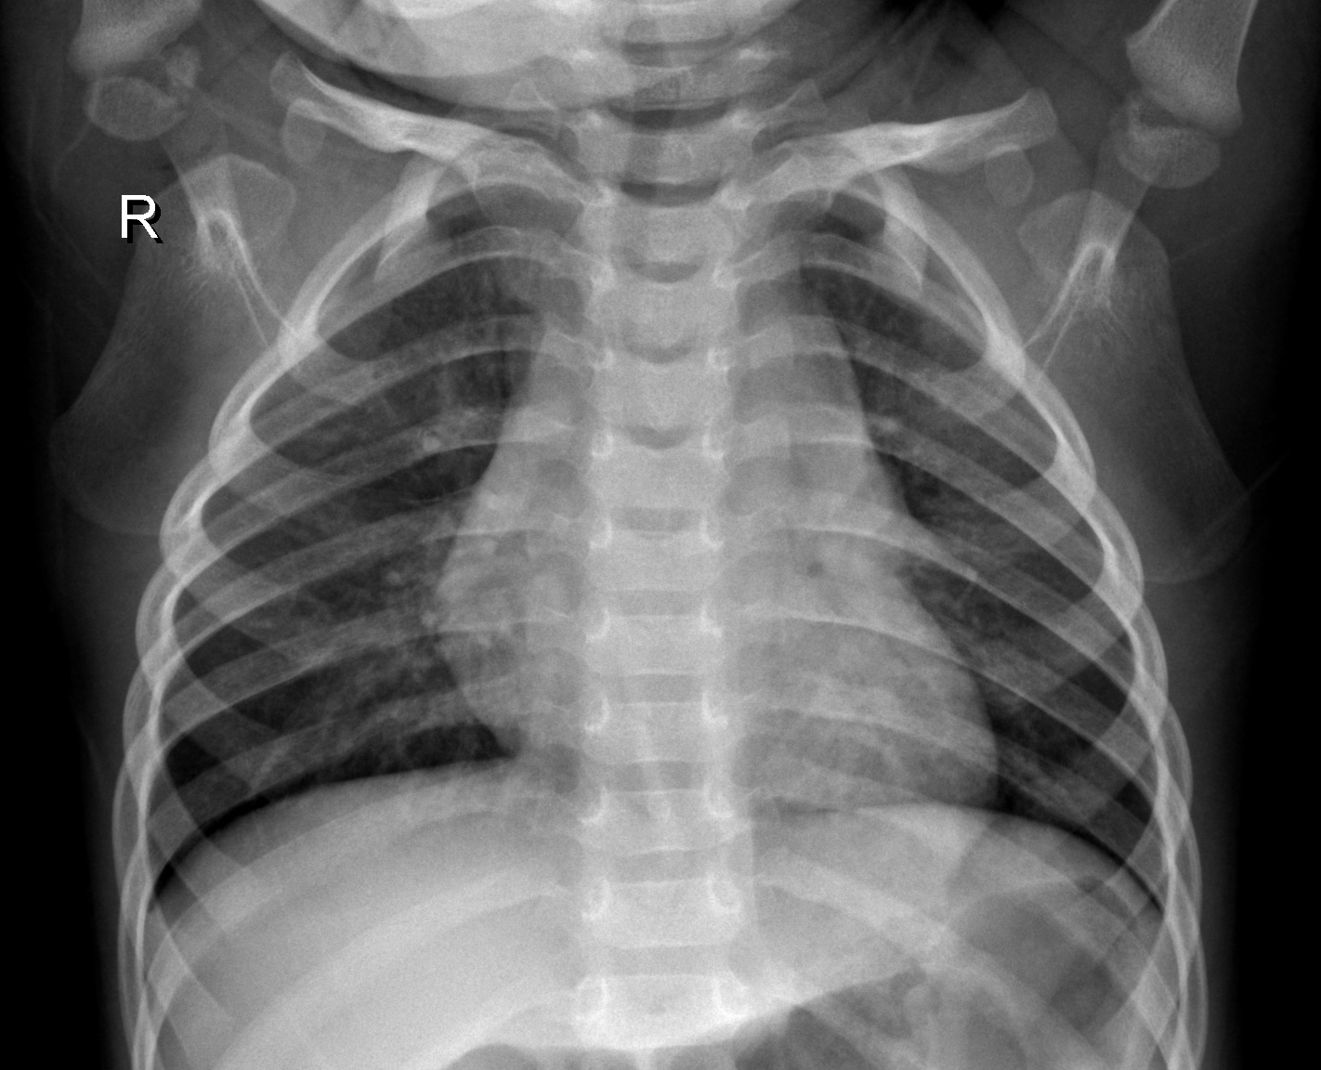
Data Augmentation
Rescale = 1/255
Zoom Range = 0.1
Rotation Range = 0.2
Horizontal-Vertical Flip
224x224 WxH
Notes:
Keras.preprocessing ImageDataGenerator
Rescaling is also done on the test set
Rotation is in terms of degrees
To prevent overfitting

Slide 7
Model Evaluations
Callbacks:
Monitoring Validation Loss
Reduce LR
Early Stopping
Model Checkpoint
ViT-B/16 and AlexNet architectures
AlexNet Layers: Input, 2 x Conv2D-MaxPool2D, 3 x Conv2D, MaxPool2D, Flatten, 3 x Dense
ViT Layers: Input, Conv2D, Reshape, 12 x Transformer Encoders, Normalization, Lambda, Dense
Notes:
Keras.callbacks: ReduceLROnPlateau, EarlyStopping, ModelCheckpoint
AlexNet:
ViT: 18 layers, no frozen layers, all trainable

Slide 8

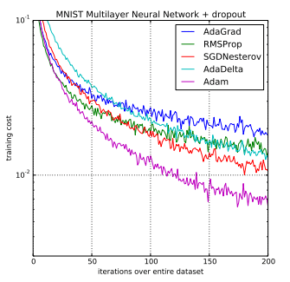
Model Evaluations
Optimizer: Adam
Loss: Binary Cross-Entropy
Max. # of 50 Epochs
Notes:
Optimizer: Adam
Loss: Binary Cross-Entropy because there are only 2 classes

Slide 9
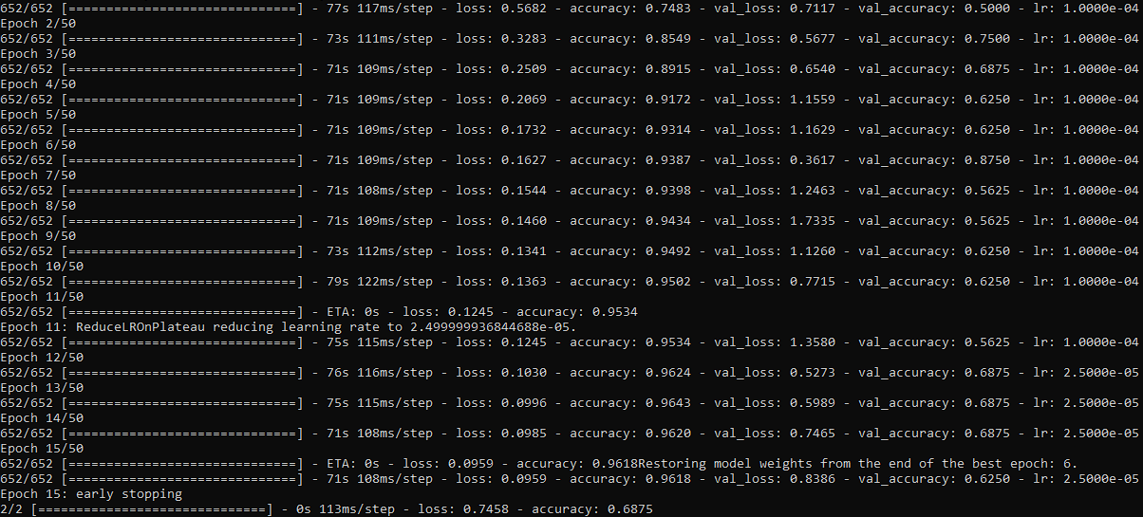
AlexNet CNN

Slide 10
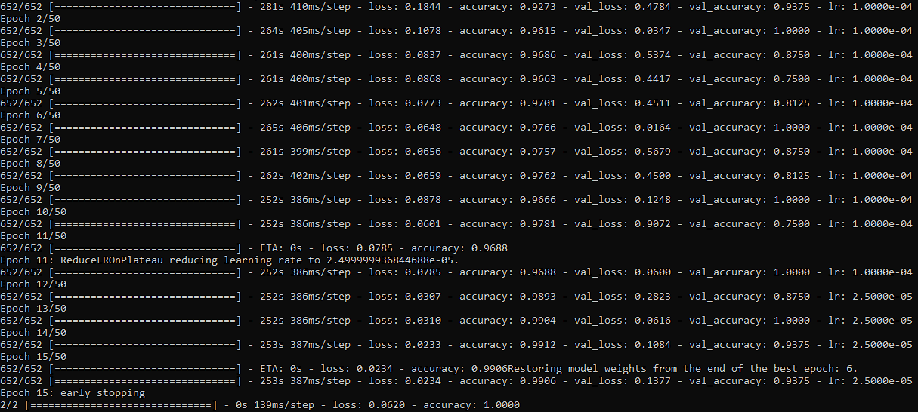
Vision Transformer

Slide 11
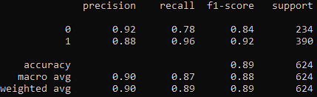
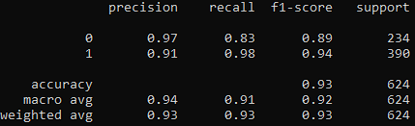
Results
0: Healthy
1: Pneumonia
AlexNet: 0.89
ViT: 0.93
AlexNet CNN
Vision Transformer
Notes:
Sklearn.metrics classification_report

Slide 12
Conclusion
Setting up AlexNet and ViT models
Data augmentation
Model evaluations
Comparing CNN and ViT
Faster training: AlexNet
More accurate: ViT
Notes:
AlexNet 20 min training time
ViT 60 min training time

Slide 13
References
[1] D. S. Kermany, et al., Identifying Medical Diagnoses and Treatable Diseases by Image-Based Deep Learning, 2018. [Online]. Available: https://www.cell.com/cell/fulltext/S0092-8674(18)30154-5.

